Slide 1
EPS/Fault Management Software
Jimmy Nguyen
Electrical Power Subsystem Member

Slide 2
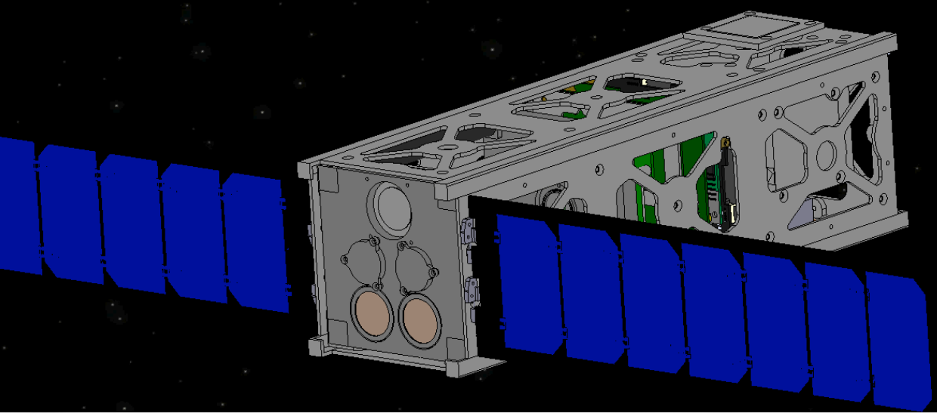
Overview
Hardware implemented protection
Fault software
Photodiode angle conversion
SDS-1 Simulation

Slide 3
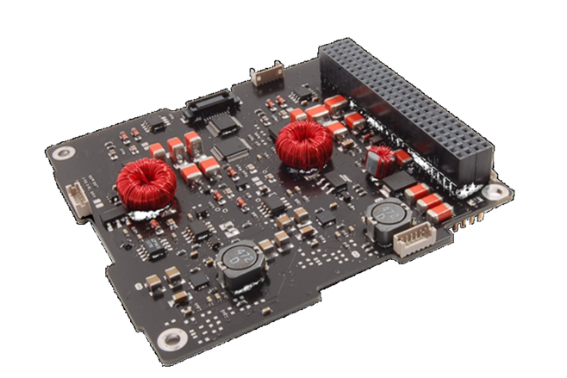
Hardware Implemented Protection
ClydeSpace – EPS Board, Solar Panels, Battery
Over-Current Bus Protection
  Solid state switches
Battery Under-Voltage
  To prevent over discharge
  Uses comparator circuit w/
  hysteresis.
EPS Board
(Courtesy of ClydeSpace)

Slide 4
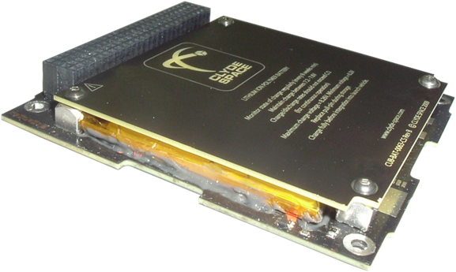
Hardware Implemented Protection
Battery Over-Current
-Polyswitch protection
- Shuts down supply busses
Stand-Alone Battery
(Courtesy of ClydeSpace)

Slide 5
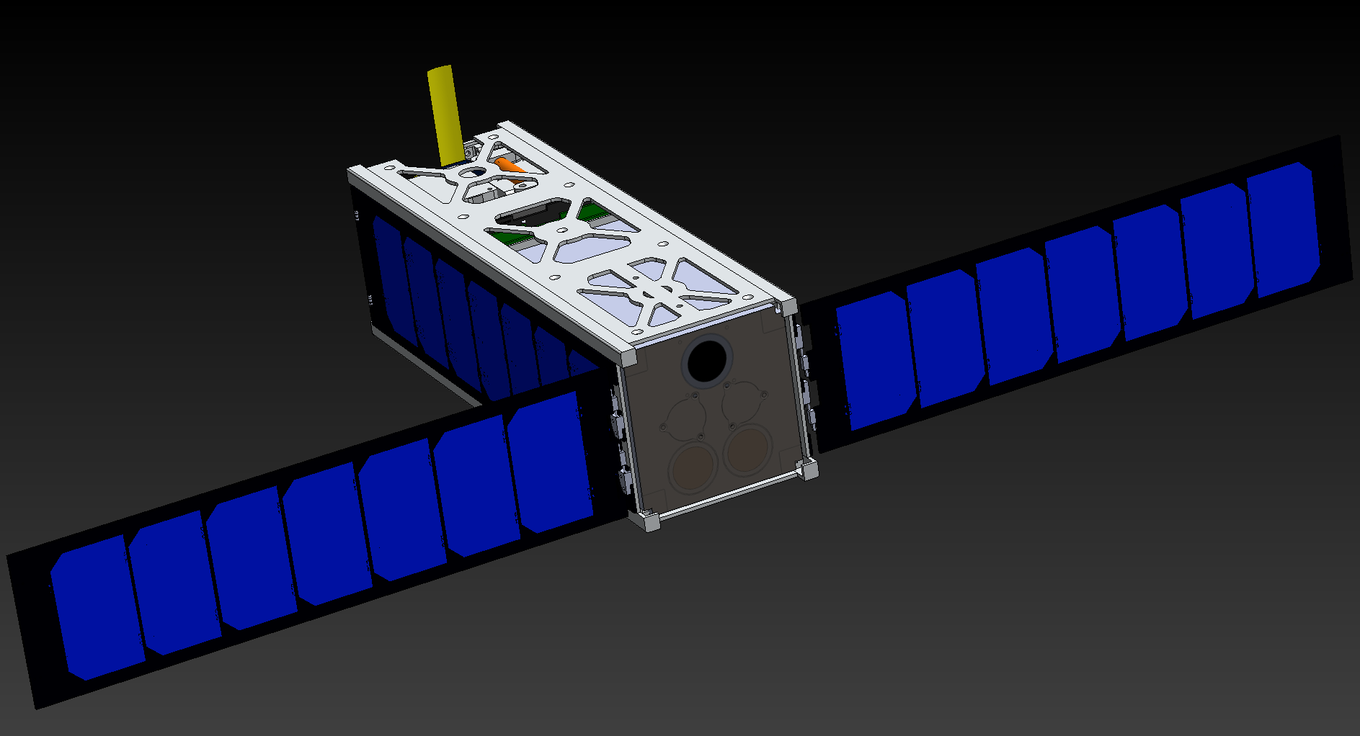
Power Modes
Full Load
Normal Operation A
Normal Operation B
Normal Operation C
Normal Operation D
Standby Mode
Load Shed Mode
SDS-1 Simulation

Slide 6
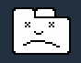
Major Problem
How do we communicate if all components are off?
- Hardware never powers off forever
Chrome error icon

Slide 7
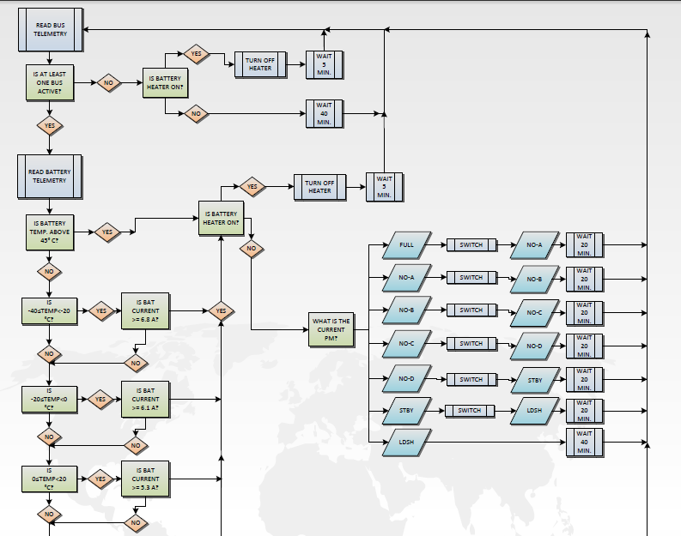
EPS Fault Management Flow Diagram

Slide 8
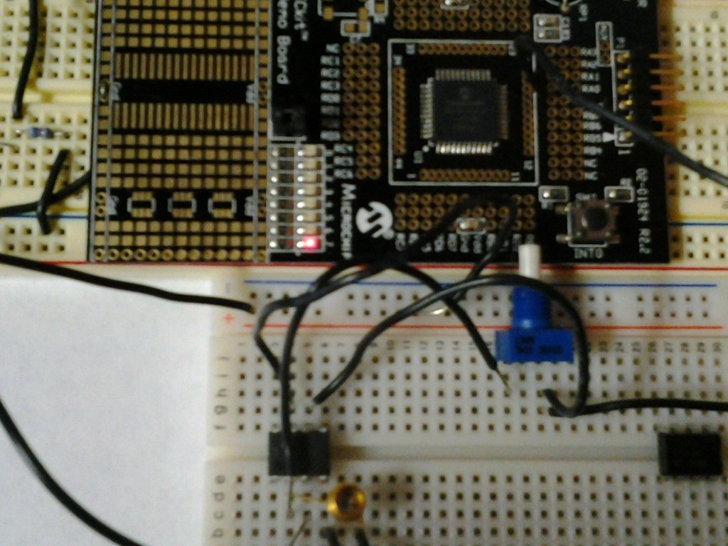
Photodiode
Angle conversion using PIC microcontroller
Testing stages
Photodiode Demo Setup

Slide 9
Questions or Comments?
Name: Jimmy Nguyen
Website: http://sdsl.club.asu.edu/
Email: jnguye22@asu.edu

